Slide 1
Informatic Securisys Solutions
Corporate Profile
January 2019

Slide 2
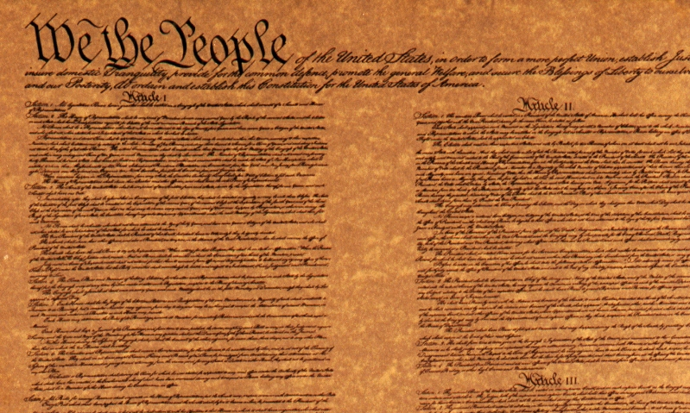
Informatic Securisys Solutions………
We implement “Solutions to Protect” in two distinct ways…
We provide information technology based services to ensure the security of Countries , their people, their businesses, and the principles on which their constitution is based
We provide technology-based services and products for identification and access control, the very basis of a government

Slide 3
Informatic Securisys Solutions………
Informatic Securysis Solutions Inc (ITS), understands through our years of experience, the full spectrum of security solutions and the pros and cons of each.
Provider of advanced identification products and services based on 80 years experience in international projects.
Strong strategic alliances and joint marketing relationships in the world to leverage our technical expertise.
Business approach:
Global Experience in Identification Systems
New Generation of Access Control Systems
Utilization of non-proprietary tools yield lower cost and greater cross platform capability.
Turnkey Approach to Hardware and Software needs

Slide 4
Universal Identification Solutions …..
International Expertise in Civil Registration & Identification
Qualified ITS personnel
Past performance in Latin America & Europe
Understanding of business opportunity/development
Leverage existing relationships
Fully developed HW and SW solutions
Our Goal – Execute Full Integration Projects
With Security Solutions and Presence in Latin America
Leverage our Products as part of a total solution

Slide 5
Functional Areas
Information Technology Services
Management Consulting
Hardware/ Software Products
Advanced Technology Tools

Slide 6
Information Technology Services
Offerings
Database Management Applications
Database Design and Development
Database Administration
Operations Research
LAN/WAN Integration
Computer Facilities Management
Network Engineering and Support
Imaging and Workflow Technologies
Requirements Analysis
Strategic Technical/ Management Planning
Telecommunications Consulting
System Administration
IT System Deployment
Our Distinction
Utilization of non-proprietary tools yields lower cost and greater cross platform capability

Slide 7
Management Consulting
Offerings
Marketing Consulting
General Management Consulting
Strategic Planning
(Ops, Tech, Budget)
Productivity Analysis
Feasibility Studies
Operational Reviews
Vulnerability Assessment Consulting
Our Distinction
Identification Systems
Security and Intelligence Sector
Access Control

Slide 8
Hardware & Software Products
ITS Products
EDCLT21 – Electronic Device for Multiple Contactless Transactions
SAMAC21- Smart Application for Multiple Access Control Level
SUPERWATSON – Specialize Software for Intelligence Community and Government Sector
Identification Software
Access Control HW & SW
Hardware and Software Vendor Alliances
“one stop shopping" consulting organization
Our Distinction
Turn-Key Approach to HW and SW needs
ALL-IN-ONE
Utilization of non-proprietary tools yields lower cost and greater cross platform capability

Slide 9
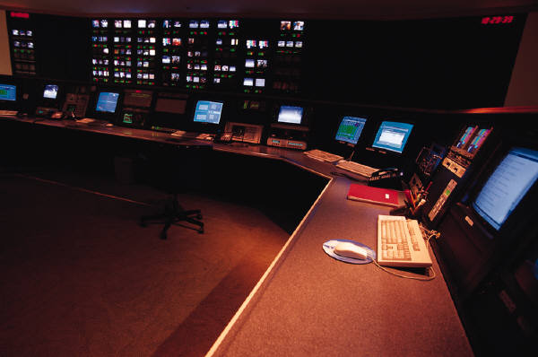
Advanced Technology Tools
Our Distinction
Utilization of non-proprietary tools
Cross platform capability
Best Value Solutions
Offerings
Biometric recognition
Finger Scan
Iris Scan
Access Control Level
SAMAC21
Security Software (SUPERWATSON)
Multiple Contactless Transactions

Slide 10
Applications & Vertical Markets
1. National ID Cards
3. Intelligence Community
4. Law Enforcement
5. Access Control
6. Network Security
7. Tally Results
1. Government
2. Financial
3. Health Care
4. Defense
5. Transportation
1. Americas
- South America
- North America
- Central America
- Caribbean
2. Africa
3. Asia Pacific
4. Europe
APLICATION MARKETS
VERTICAL MARKETS
GEOGRAPHIC
TERRITORY

Slide 11
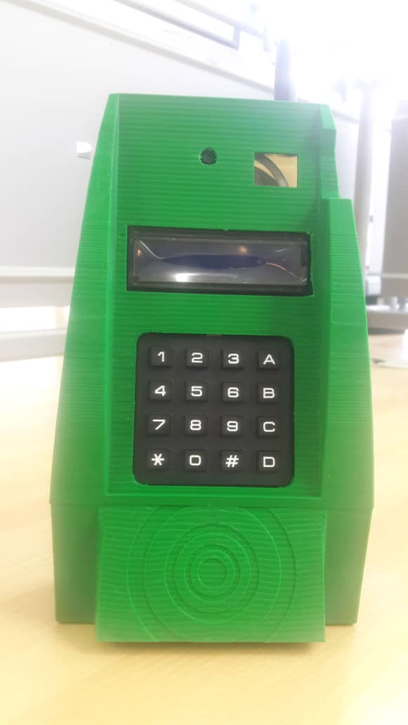
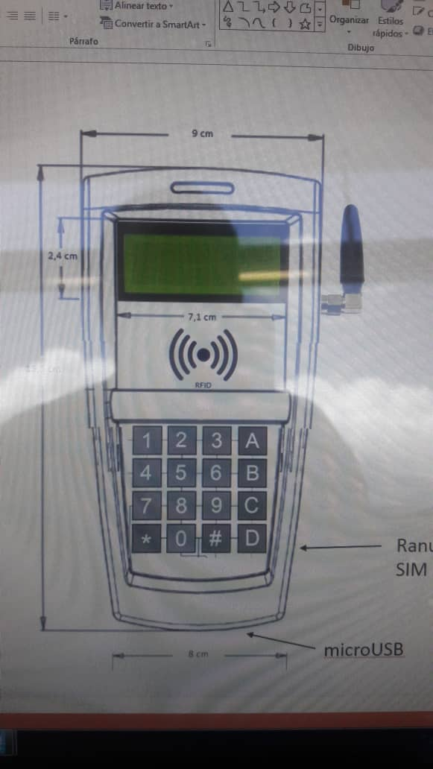
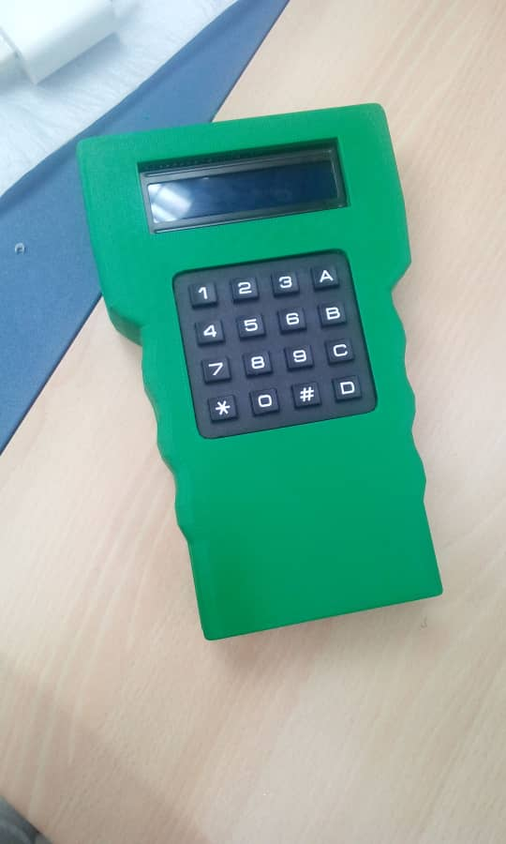
Electronic Device Multiple Contacless Transactions………
The EDCL2021 Features:
Voltage regulator 12 volts
RFID Card
Raspberry Pi Zero 4.
Display) display = 2x16 5.
Horn 6 two LEDs (red and green).

Slide 12
SUPERWATSON General Overview
General Overview
SUPERWATSON is the result of more than seven (7) years of work of a research and development team of PROFESSIONALS from Citizens of different nationalities working in different countries
Unprecedented technologically advanced

Slide 13
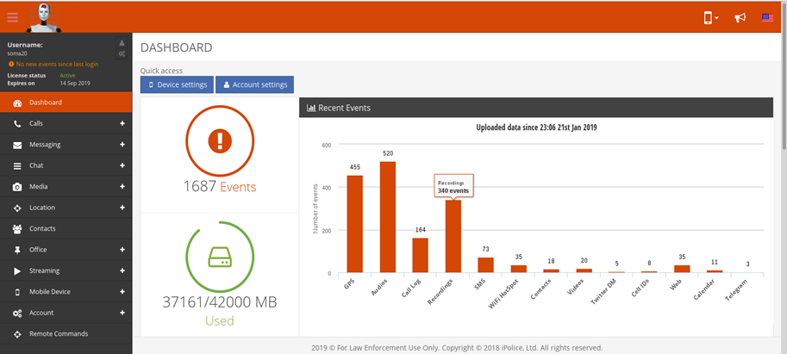
SUPERWATSON General Overview
General Overview
Product, which amply satisfies a set of key needs in the intelligence and state security sector. These two areas have been significantly affected by the disappearance of companies and working groups that carried out developments in them and desisted from continuing to invest the large sums of money and high-level resources demanded In projects of these characteristics

Slide 14
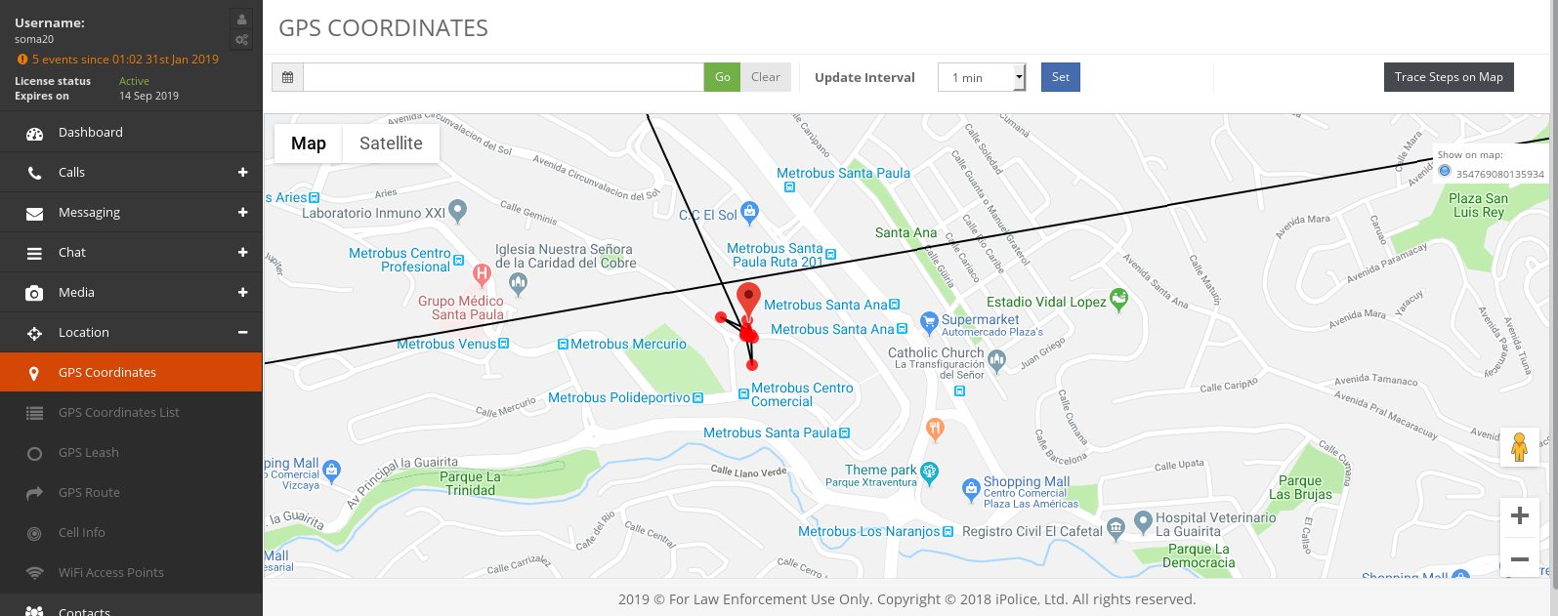
SUPERWATSON General Overview
General Overview
SUPERWATSON is an advanced piece of technology, unique in the world, developed with resources Completely private and without any technical or other ties to any government.

Slide 15
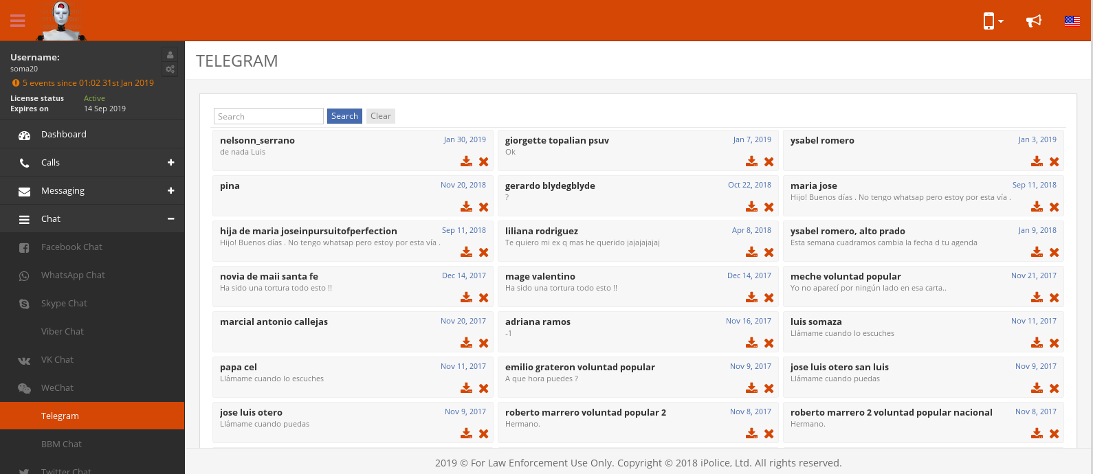
SUPERWATSON Detail Description
Technical Description
The Superwatson system allows access to the following information:
when a target is incorporated into it.
Incoming, outgoing and lost calls, with automatic recording, without any human intervention and full duplex of high quality, without need of any support of the telephone operators.
Text messaging: SMS, WhatsApp, WeChat, Telegram, Twitter, Facebook, Viber and others.
Notes received and sent by WHATSAPP.

Slide 16
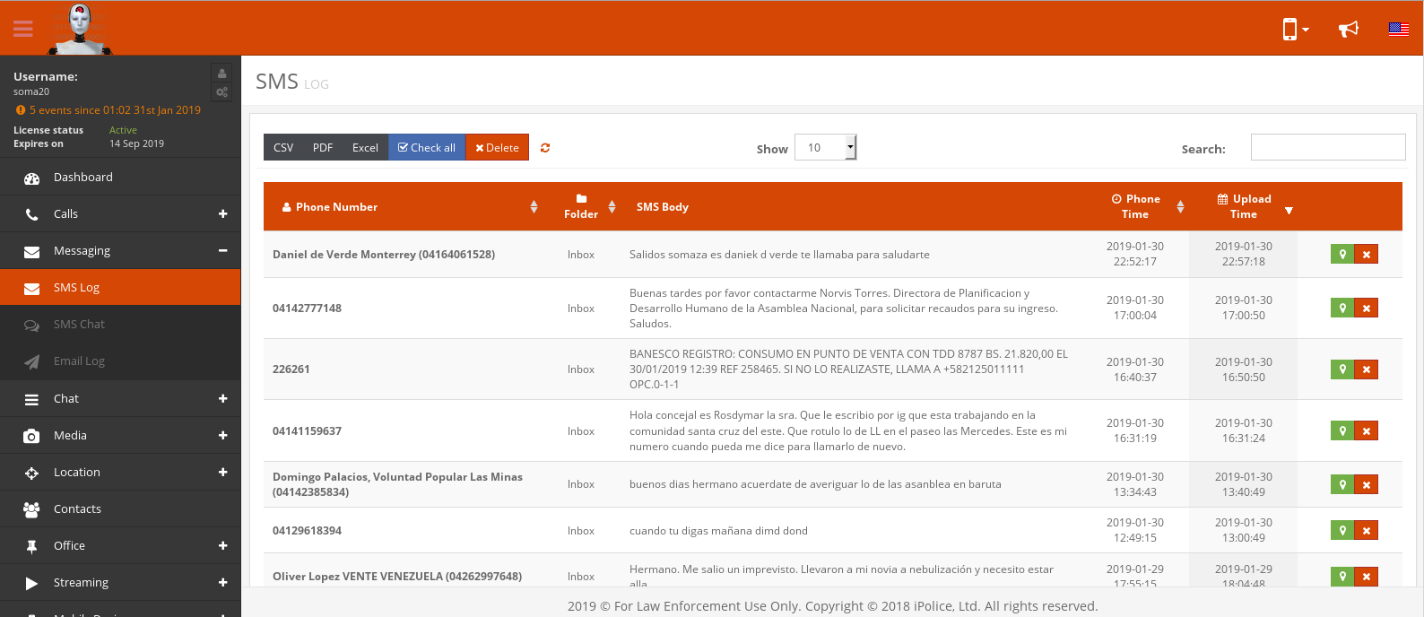
SUPERWATSON Detail Description
Technical Description
Ambient Audio through a special phone.
Photos received by any messaging system included WhatsApp or taken with the device.
Videos received or made with the device registered emails on the device.
Device Location-accurately one (1) meter-built-in to Google Maps. Location with nearby cells.
Location history. History of visited websites.
Calendar with their events.

Slide 17
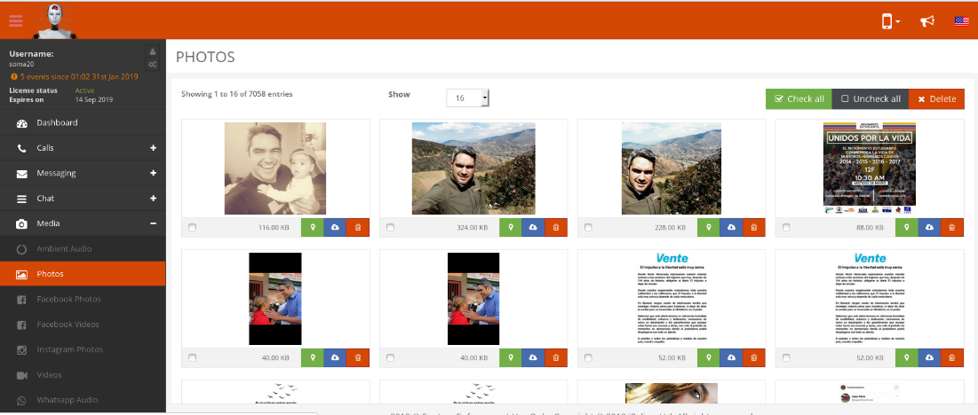
SUPERWATSON Detail Description
Technical Description
Ability to prevent in a specific time the use of any application of those installed on the device e.g. WHATSAPP.
Ability to define the report (Periodicity) time of activities or events of the user p. Example report on the location of the target every certain time “one (1) minute, fifteen (15) minutes or deemed appropriate”.
Ability to receive an alert depending on a keyword, e.g. attack, strike, kill etc.

Slide 18
Thank You!
Informatic Securisys Solutions Inc
8114 Firenze Boulevard, Orlando Fl 32836
www.securisysnow.com
www.lakelandheight.com

